Slide 1
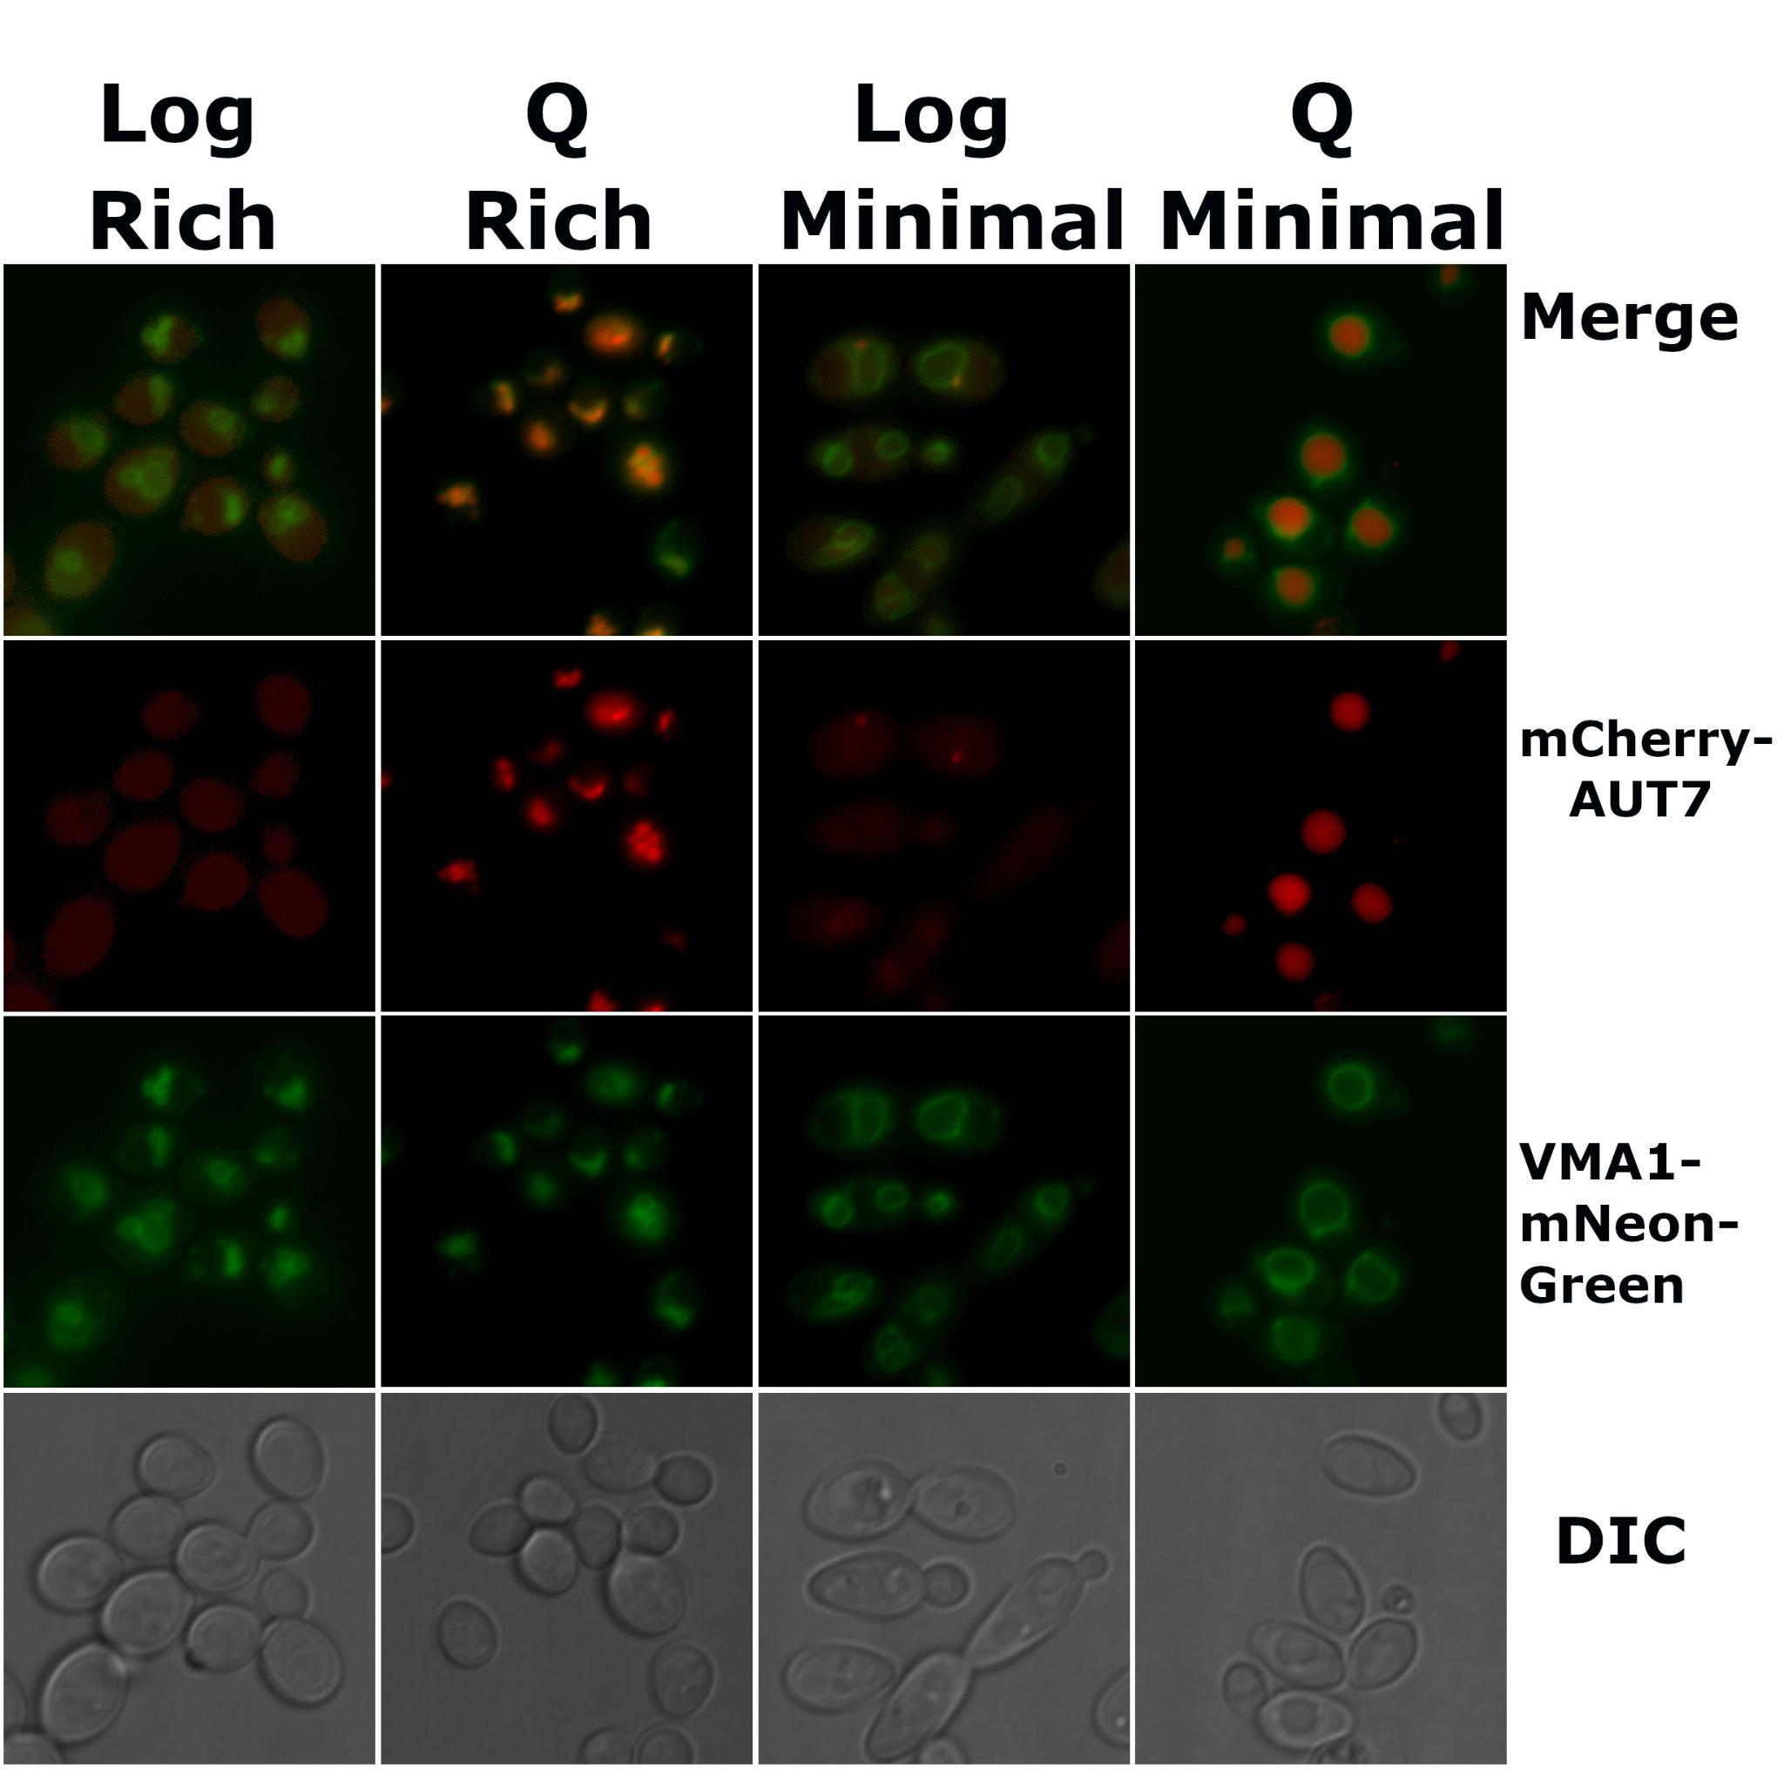
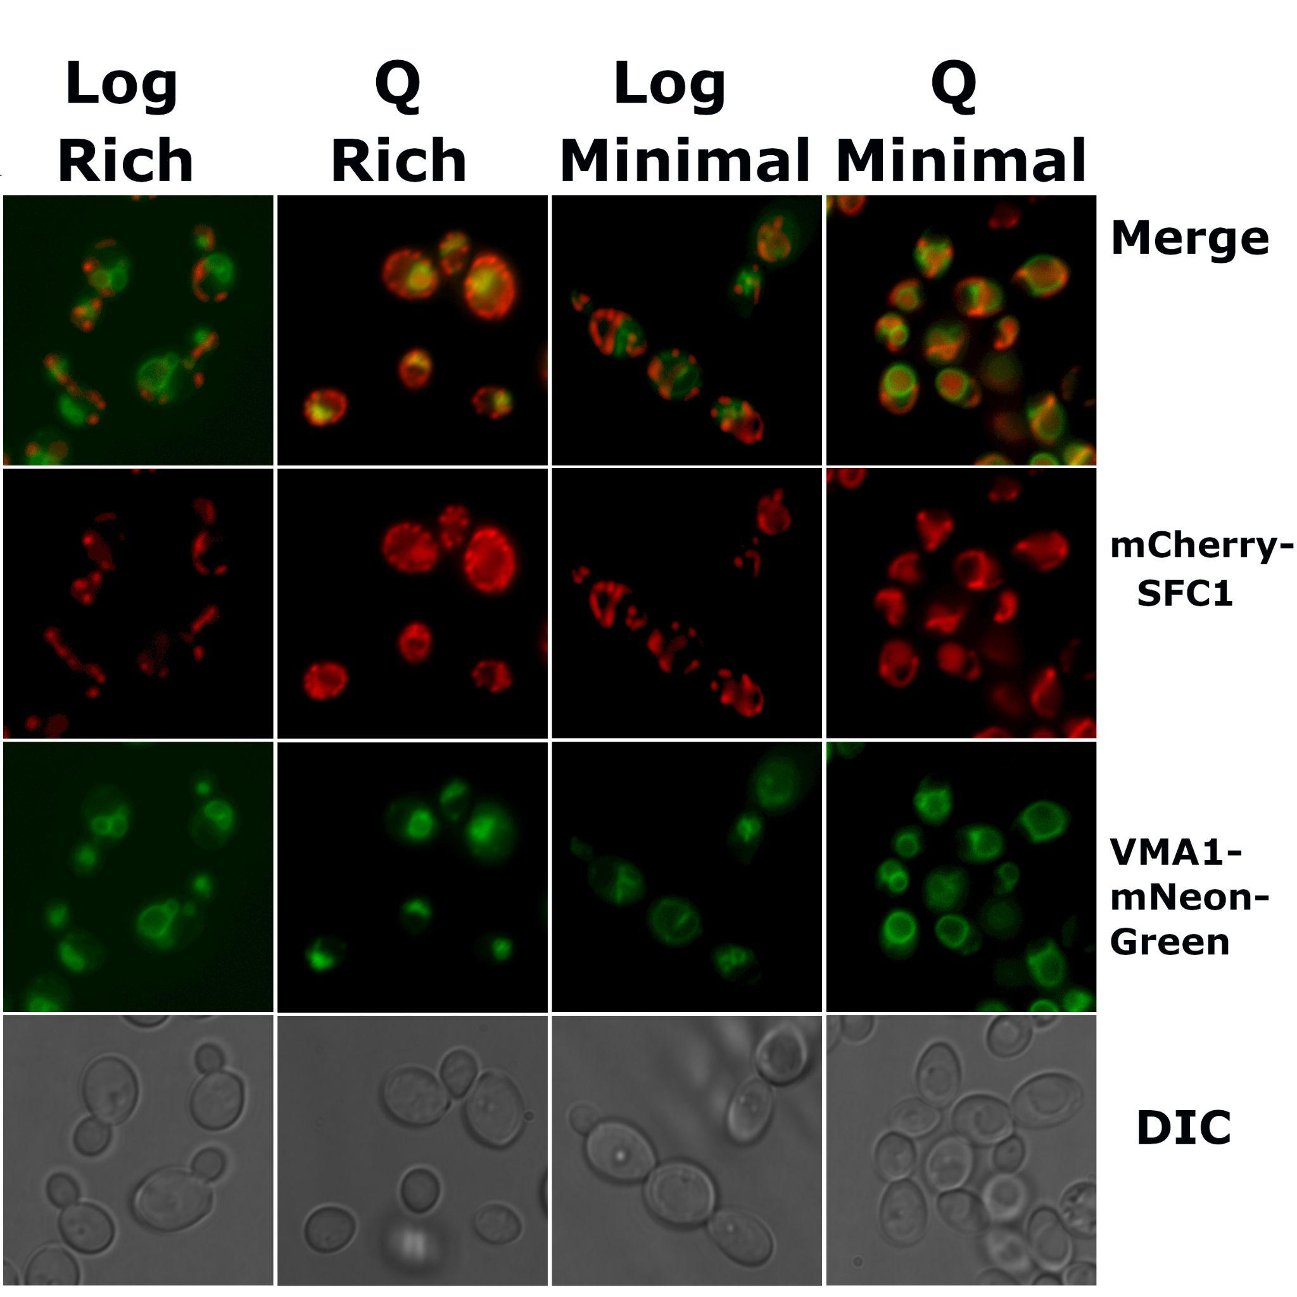
A
B
Notes:
Figure 2. 72-hour quiescent cultures undergo autophogy. A) AUT7 and VMA1 colocalize in quiescent cultures. B) SFC1 and VMA1 show minimal colocalization in quiescent cultures.

